Slide 1
Image Processing
Introduction (Chapter 1)
Nashib Acharya
nashibacharya@gmail.com
Suman Sharma
seeiumaan@gmail.com
Notes:
1

Slide 2
Introduction
“One picture is worth more than ten thousand words”
Anonymous
Notes:
2

Slide 3
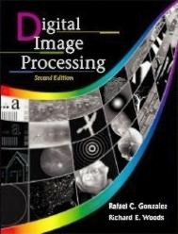
References
Text / Reference books:
1. K. Castlemann, “Digital Image Processing”, Prentice Hall of India Ltd., 1996.
2. A. K. Jain, “Fundamental of Digital Image Processing”, Prentice Hall of India Pvt. Ltd., 1995.
3. R. C. Gonzalez and P. Wintz, “Digital Image Processing”, Addison-Wesley Publishing, 1987.
4. Sing_Tze Bow, M. Dekker, “Pattern Recognition and Image Processing”, 1992
5. M. James, “Pattern Recognition”, BSP professional books, 1987.
6. P. Monique and M. Dekker, “Fundamentals of Pattern Recognition”, 1989.
“Digital Image Processing”, Rafael C. Gonzalez & Richard E. Woods, Addison-Wesley, 2002
Much of the material that follows is taken from this book
Notes:
3

Slide 4
Contents
This lecture will cover:
What is a digital image?
What is digital image processing?
History of digital image processing
State of the art examples of digital image processing
Key stages in digital image processing
Sampling and Quantization
Relationship between Pixels
Notes:
4

Slide 5


What is a Digital Image?
A digital image is a representation of a two-dimensional image as a finite set of digital values, called picture elements or pixels
Images taken from Gonzalez & Woods, Digital Image Processing (2002)
Notes:
5
Real world is continuous – an image is simply a digital approximation of this.
Digital image processing is the use of computer algorithms to perform image processing on digital image.

Slide 6

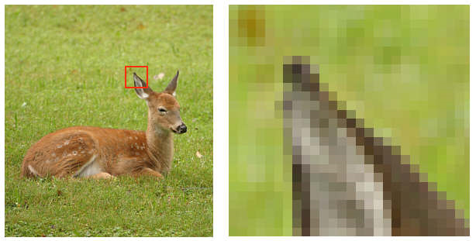
What is a Digital Image? (cont…)
Pixel values typically represent gray levels, colors, heights, opacities etc.
Remember digitization implies that a digital image is an approximation of a real scene
1 pixel
Notes:
6
the smallest addressable element in an all points addressable display device.

Slide 7
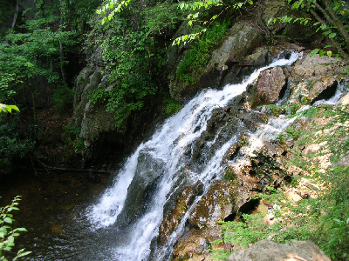

What is a Digital Image? (cont…)
Common image formats include:
1 sample per point (B&W or Grayscale)
3 samples per point (Red, Green, and Blue)
4 samples per point (Red, Green, Blue, and “Alpha”, aka Opacity)
For most of this course we will focus on grey-scale images
Notes:
7
In photography and computing, a gray scale or grey scale digital image is an image in which the value of each pixel is a single sample, that is, it carries only intensity information. Images of this sort, also known as black-and-white, are composed exclusively of shades of gray, varying from black at the weakest intensity to white at the strongest.

Slide 8
What is Digital Image Processing?
Digital image processing focuses on two major tasks
Improvement of pictorial information for human interpretation
Processing of image data for storage, transmission and representation for autonomous machine perception
Some argument about where image processing ends and fields such as image analysis and computer vision start
Notes:
8

Slide 9
What is DIP? (cont…)
The continuum from image processing to computer vision can be broken up into low-, mid- and high-level processes
Low Level Process
Mid Level Process
High Level Process
Input: Image Output: Image
Examples: Noise removal, image sharpening
Input: Image Output: Attributes
Examples: Object recognition, segmentation
Input: Attributes Output: Understanding
Examples: Scene understanding, autonomous navigation
In this course we will stop here
Notes:
9
Give the analogy of the character recognition system.
Low Level: Cleaning up the image of some text
Mid level: Segmenting the text from the background and recognising individual characters
High level: Understanding what the text says

Slide 10
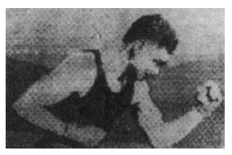
History of Digital Image Processing
Early 1920s: One of the first applications of digital imaging was in the news- paper industry
The Bartlane cable picture transmission service
Images were transferred by submarine cable between London and New York
Pictures were coded for cable transfer and reconstructed at the receiving end on a telegraph printer
Early digital image
Images taken from Gonzalez & Woods, Digital Image Processing (2002)
Notes:
10

Slide 11
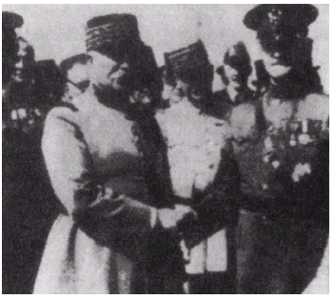
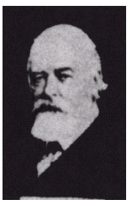
History of DIP (cont…)
Mid to late 1920s: Improvements to the Bartlane system resulted in higher quality images
New reproduction processes based on photographic techniques
Increased number of tones in reproduced images
Images taken from Gonzalez & Woods, Digital Image Processing (2002)
Improved digital image
Early 15 tone digital image
Notes:
11
In photography, toning is a method of changing the color of black-and-white.

Slide 12
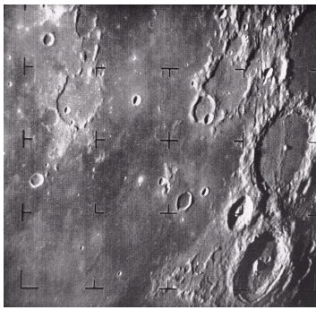
History of DIP (cont…)
1960s: Improvements in computing technology and the onset of the space race led to a surge of work in digital image processing
1964: Computers used to improve the quality of images of the moon taken by the Ranger 7 probe
Such techniques were used in other space missions including the Apollo landings
Images taken from Gonzalez & Woods, Digital Image Processing (2002)
A picture of the moon taken by the Ranger 7 probe minutes before landing
Notes:
12

Slide 13
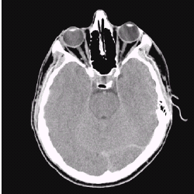
History of DIP (cont…)
1970s: Digital image processing begins to be used in medical applications
1979: Sir Godfrey N. Hounsfield & Prof. Allan M. Cormack share the Nobel Prize in medicine for the invention of tomography, the technology behind Computerised Axial Tomography (CAT) scans
Images taken from Gonzalez & Woods, Digital Image Processing (2002)
Typical head slice CAT image
Notes:
13

Slide 14
History of DIP (cont…)
1980s - Today: The use of digital image processing techniques has exploded and they are now used for all kinds of tasks in all kinds of areas
Image enhancement/restoration
Artistic effects
Medical visualisation
Industrial inspection
Law enforcement
Human computer interfaces
Notes:
14

Slide 15
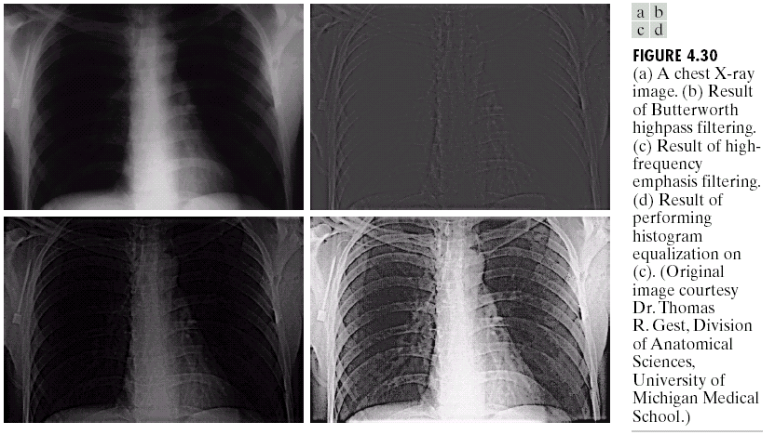
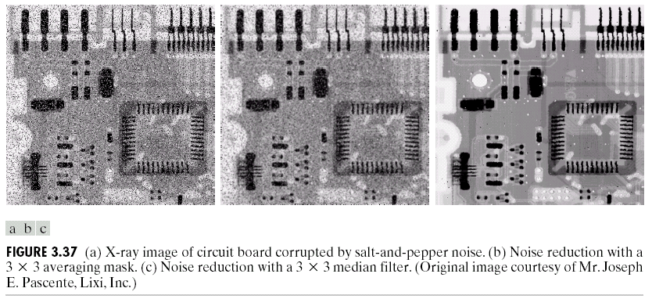
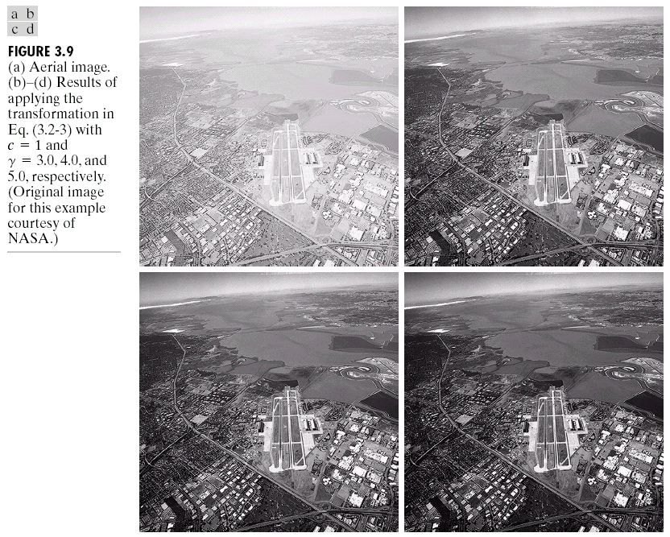
Examples: Image Enhancement
One of the most common uses of DIP techniques: improve quality, remove noise etc
Images taken from Gonzalez & Woods, Digital Image Processing (2002)
Notes:
15

Slide 16
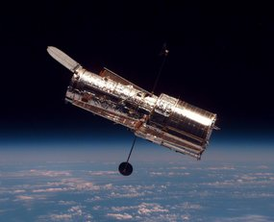
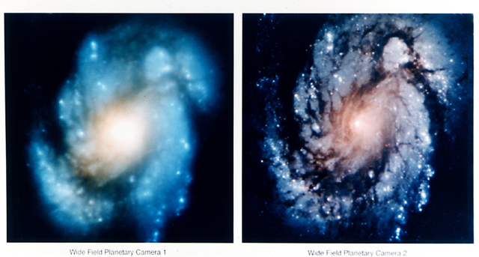
Examples: The Hubble Telescope
Launched in 1990 the Hubble telescope can take images of very distant objects
However, an incorrect mirror made many of Hubble’s images useless
Image processing techniques were used to fix this
Notes:
16

Slide 17
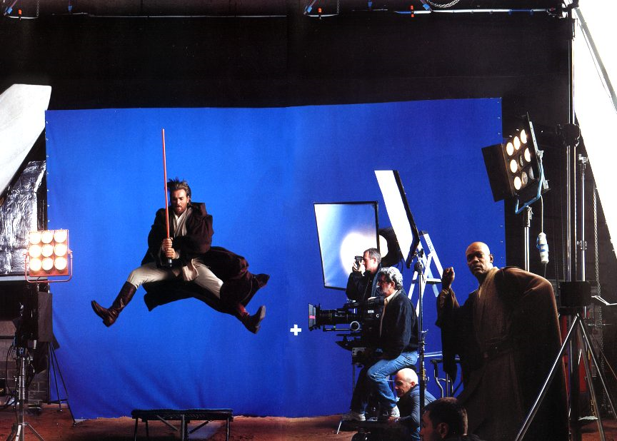
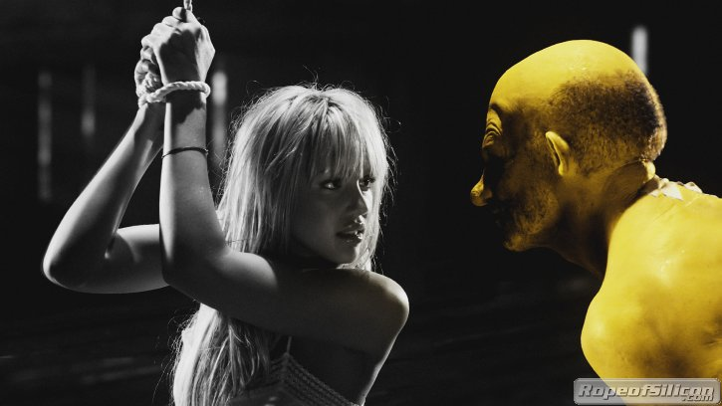
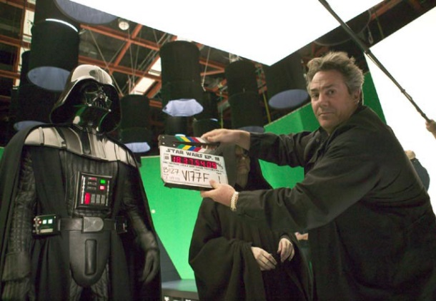
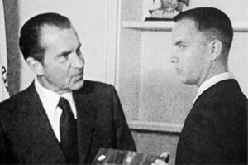
Examples: Artistic Effects
Artistic effects are used to make images more visually appealing, to add special effects and to make composite images
Notes:
17

Slide 18
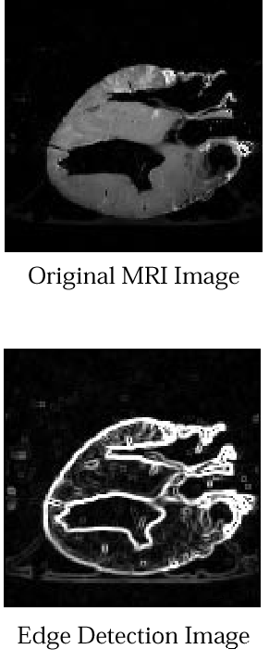
Examples: Medicine
Take slice from MRI scan of canine heart, and find boundaries between types of tissue
Image with gray levels representing tissue density
Use a suitable filter to highlight edges
Images taken from Gonzalez & Woods, Digital Image Processing (2002)
Original MRI Image of a Dog Heart
Edge Detection Image
Notes:
18

Slide 19
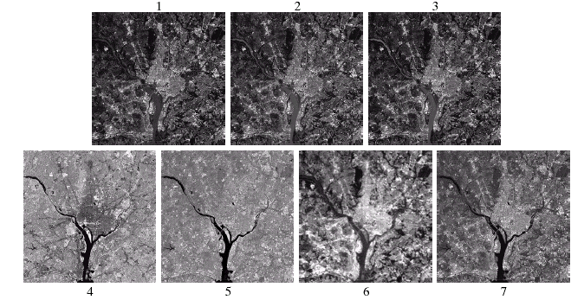
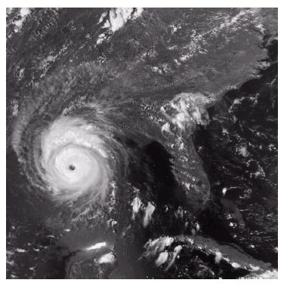
Examples: GIS
Geographic Information Systems
Digital image processing techniques are used extensively to manipulate satellite imagery
Terrain classification
Meteorology
Images taken from Gonzalez & Woods, Digital Image Processing (2002)
Notes:
19

Slide 20
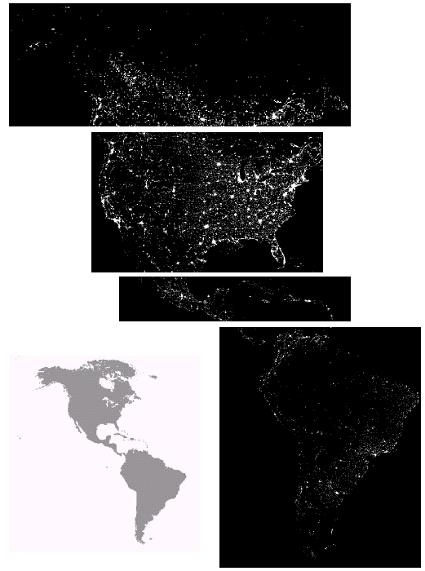
Examples: GIS (cont…)
Night-Time Lights of the World data set
Global inventory of human settlement
Not hard to imagine the kind of analysis that might be done using this data
Images taken from Gonzalez & Woods, Digital Image Processing (2002)
Notes:
20

Slide 21
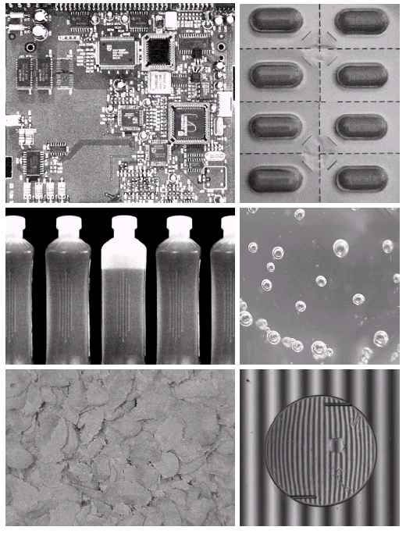
Examples: Industrial Inspection
Human operators are expensive, slow and unreliable
Make machines do the job instead
Industrial vision systems are used in all kinds of industries
Can we trust them?
Images taken from Gonzalez & Woods, Digital Image Processing (2002)
Notes:
21

Slide 22
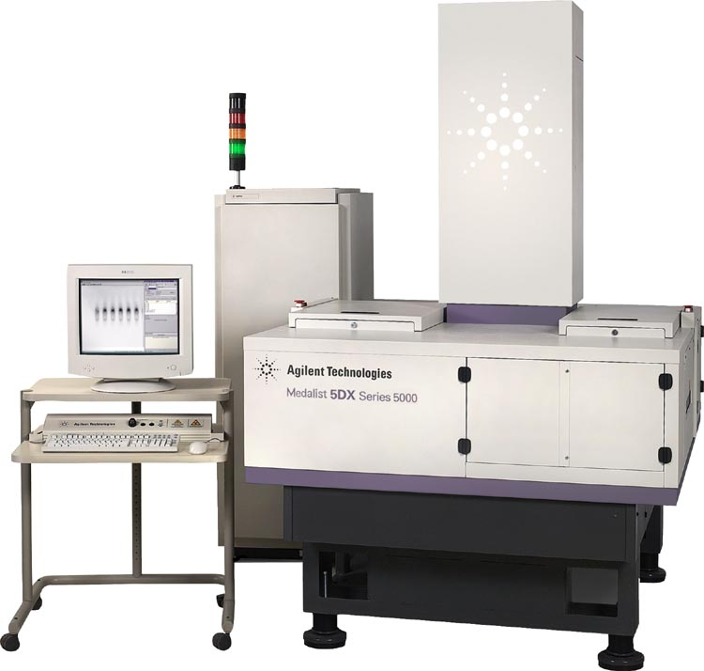
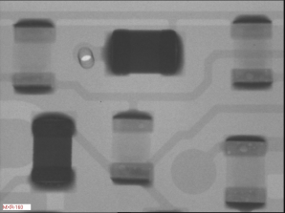
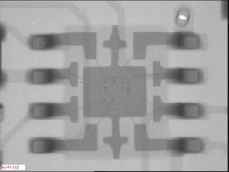
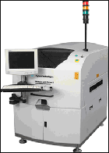
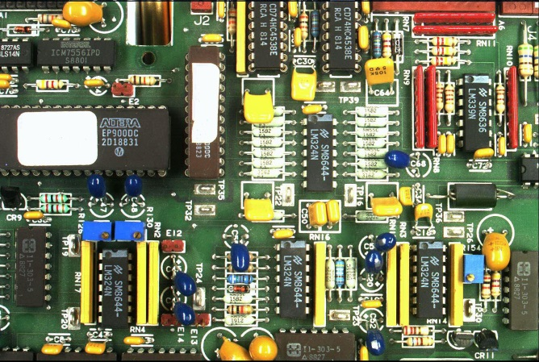
Examples: PCB Inspection
Printed Circuit Board (PCB) inspection
Machine inspection is used to determine that all components are present and that all solder joints are acceptable
Both conventional imaging and x-ray imaging are used
Notes:
22

Slide 23
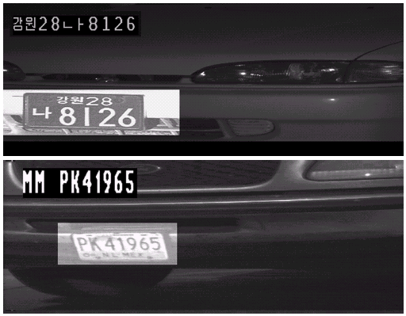
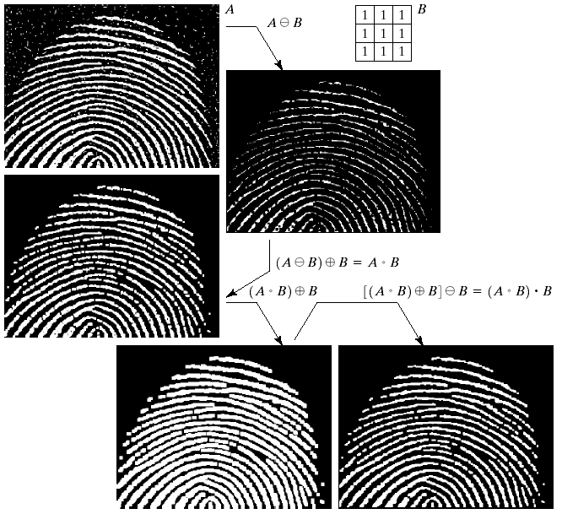
Examples: Law Enforcement
Image processing techniques are used extensively by law enforcers
Number plate recognition for speed cameras/automated toll systems
Fingerprint recognition
Enhancement of CCTV images
Images taken from Gonzalez & Woods, Digital Image Processing (2002)
Notes:
23

Slide 24
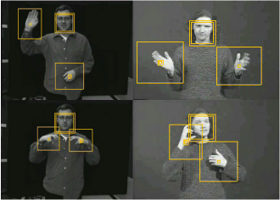
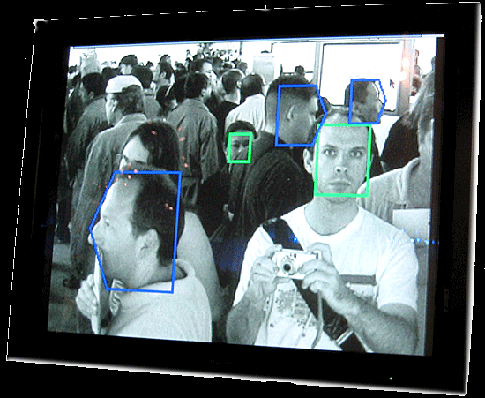
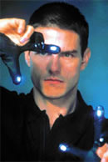
Examples: HCI
Try to make human computer interfaces more natural
Face recognition
Gesture recognition
Does anyone remember the user interface from “Minority Report”?
These tasks can be extremely difficult
Notes:
24

Slide 25
Key Stages in Digital Image Processing
Image Restoration
Morphological Processing
Image Enhancement
Segmentation
Image Acquisition
Object Recognition
Representation & Description
Problem Domain
Colour Image Processing
Image Compression
Notes:
25

Slide 26
Key Stages in Digital Image Processing: Image Aquisition
Image Restoration
Morphological Processing
Image Enhancement
Segmentation
Image Acquisition
Object Recognition
Images taken from Gonzalez & Woods, Digital Image Processing (2002)
Representation & Description
Problem Domain
Colour Image Processing
Image Compression
Notes:
26

Slide 27
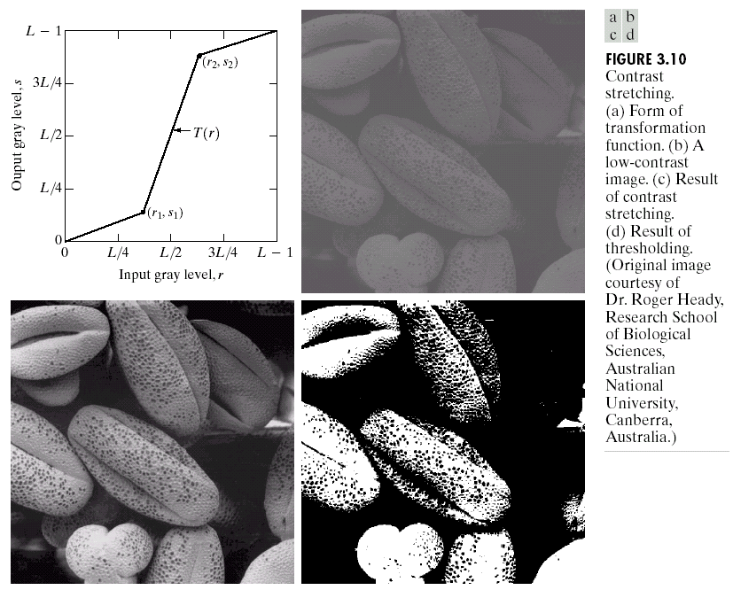
Key Stages in Digital Image Processing: Image Enhancement
Image Restoration
Morphological Processing
Image Enhancement
Segmentation
Image Acquisition
Object Recognition
Images taken from Gonzalez & Woods, Digital Image Processing (2002)
Representation & Description
Problem Domain
Colour Image Processing
Image Compression
Notes:
27

Slide 28
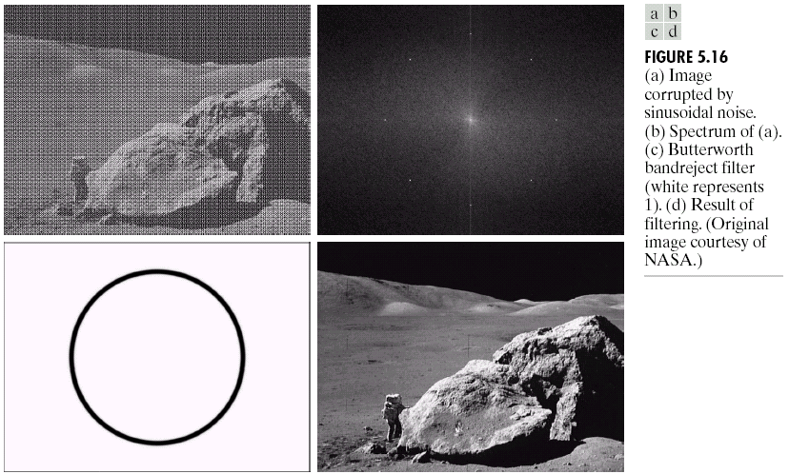
Key Stages in Digital Image Processing: Image Restoration
Image Restoration
Morphological Processing
Image Enhancement
Segmentation
Image Acquisition
Object Recognition
Images taken from Gonzalez & Woods, Digital Image Processing (2002)
Representation & Description
Problem Domain
Colour Image Processing
Image Compression
Notes:
28

Slide 29
Key Stages in Digital Image Processing: Morphological Processing
Image Restoration
Morphological Processing
Image Enhancement
Segmentation
Image Acquisition
Object Recognition
Images taken from Gonzalez & Woods, Digital Image Processing (2002)
Representation & Description
Problem Domain
Colour Image Processing
Image Compression
Notes:
29

Slide 30
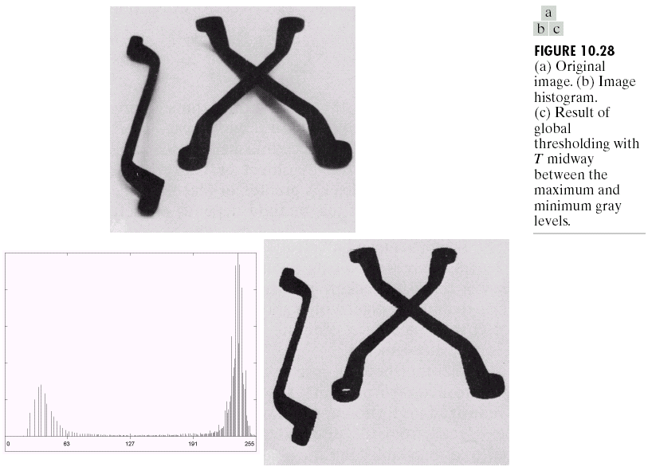
Key Stages in Digital Image Processing: Segmentation
Image Restoration
Morphological Processing
Image Enhancement
Segmentation
Image Acquisition
Object Recognition
Images taken from Gonzalez & Woods, Digital Image Processing (2002)
Representation & Description
Problem Domain
Colour Image Processing
Image Compression
Notes:
30

Slide 31
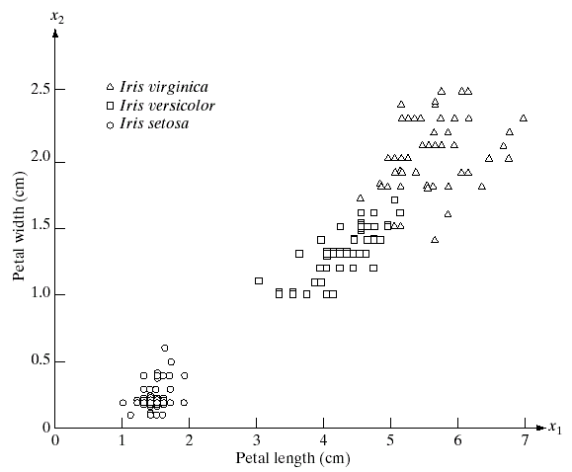
Key Stages in Digital Image Processing: Object Recognition
Image Restoration
Morphological Processing
Image Enhancement
Segmentation
Image Acquisition
Object Recognition
Images taken from Gonzalez & Woods, Digital Image Processing (2002)
Representation & Description
Problem Domain
Colour Image Processing
Image Compression
Notes:
31

Slide 32
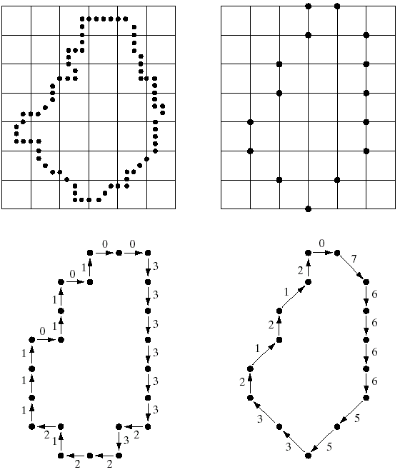
Key Stages in Digital Image Processing: Representation & Description
Image Restoration
Morphological Processing
Image Enhancement
Segmentation
Image Acquisition
Object Recognition
Images taken from Gonzalez & Woods, Digital Image Processing (2002)
Representation & Description
Problem Domain
Colour Image Processing
Image Compression
Notes:
32

Slide 33
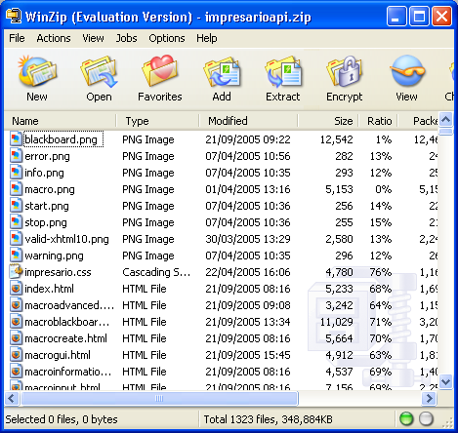
Key Stages in Digital Image Processing: Image Compression
Image Restoration
Morphological Processing
Image Enhancement
Segmentation
Image Acquisition
Object Recognition
Representation & Description
Problem Domain
Colour Image Processing
Image Compression
Notes:
33

Slide 34
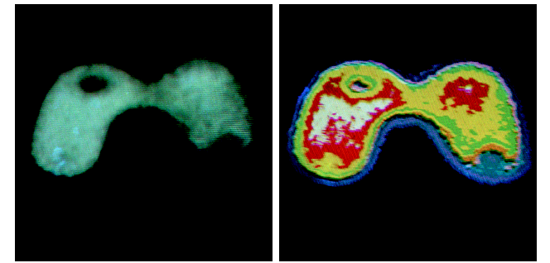
Key Stages in Digital Image Processing: Colour Image Processing
Image Restoration
Morphological Processing
Image Enhancement
Segmentation
Image Acquisition
Object Recognition
Representation & Description
Problem Domain
Colour Image Processing
Image Compression
Notes:
34

Slide 35
Summary
We have looked at:
What is a digital image?
What is digital image processing?
History of digital image processing
State of the art examples of digital image processing
Key stages in digital image processing
Notes:
35

Slide 36
Contents
This lecture will cover:
Light and the electromagnetic spectrum
Image representation
Image sensing and acquisition
Sampling, quantisation and resolution
Notes:
36

Slide 37
Brightness Adaptation & Discrimination
The human visual system can perceive approximately 10¹⁰ different light intensity levels
However, at any one time we can only discriminate between a much smaller number – brightness adaptation
Similarly, the perceived intensity of a region is related to the light intensities of the regions surrounding it
Notes:
37

Slide 38

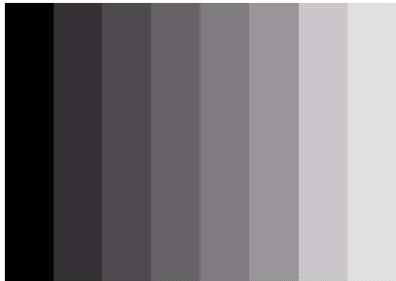

Brightness Adaptation & Discrimination (cont…)
Images taken from Gonzalez & Woods, Digital Image Processing (2002)
An example of Mach bands
Notes:
38
Mach bands were named after Ernst Mach who described the phenomenon in 1865

Slide 39
Brightness Adaptation & Discrimination (cont…)
Images taken from Gonzalez & Woods, Digital Image Processing (2002)
Notes:
39
Mach bands were named after Ernst Mach who described the phenomenon in 1865

Slide 40
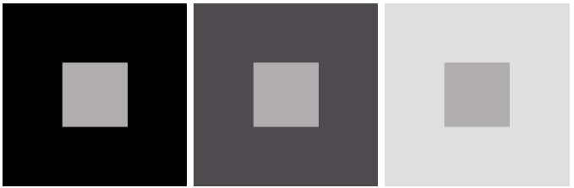
Brightness Adaptation & Discrimination (cont…)
Images taken from Gonzalez & Woods, Digital Image Processing (2002)
An example of simultaneous contrast
Notes:
40
Mach bands were named after Ernst Mach who described the phenomenon in 1865

Slide 41
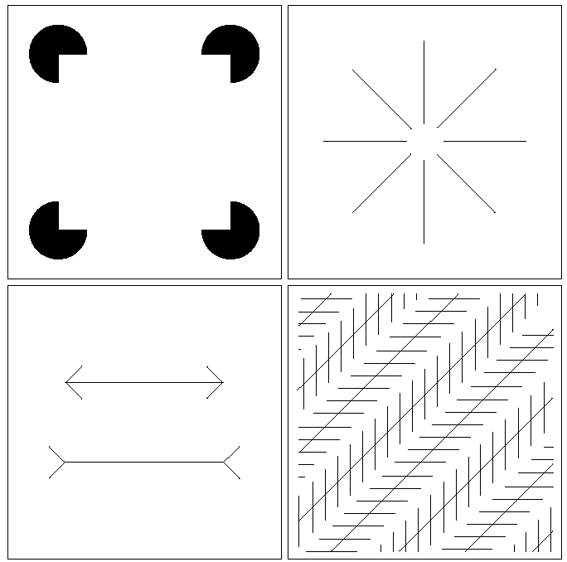
Optical Illusions
Our visual systems play lots of interesting tricks on us
Notes:
41

Slide 42
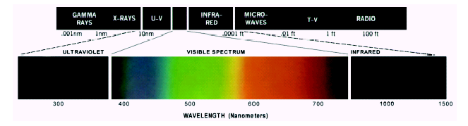
Light And The Electromagnetic Spectrum
Light is just a particular part of the electromagnetic spectrum that can be sensed by the human eye
The electromagnetic spectrum is split up according to the wavelengths of different forms of energy
Notes:
42
In 1666 Sir Isaac Newton discovered that light passed through a prism splits into a continuous spectrum of colours
Many image applications use electromagnetic radiation that is far outside the visual spectrum – x-ray images, infra-red images – we genrate images of these images by mapping them to the visual spectrum

Slide 43

Reflected Light
The colours that we perceive are determined by the nature of the light reflected from an object
For example, if white light is shone onto a green object most wavelengths are absorbed, while green light is reflected from the object
White Light
Colours Absorbed
Green Light
Notes:
43

Slide 44
Sampling, Quantisation And Resolution
In the following slides we will consider what is involved in capturing a digital image of a real-world scene
Image sensing and representation
Sampling and quantisation
Resolution
Notes:
44

Slide 45
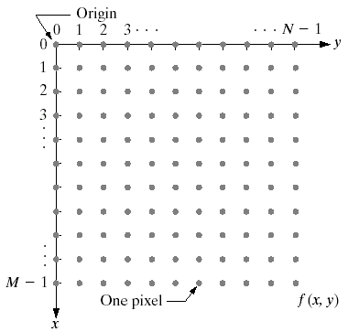
Image Representation
Before we discuss image acquisition recall that a digital image is composed of M rows and N columns of pixels each storing a value
Pixel values are most often grey levels in the range 0-255(black-white)
We will see later on that images can easily be represented as matrices
col
Images taken from Gonzalez & Woods, Digital Image Processing (2002)
f (row, col)
row
Notes:
45

Slide 46
Image Acquisition
Images are typically generated by illuminating a scene and absorbing the energy reflected by the objects in that scene
Typical notions of illumination and scene can be way off:
X-rays of a skeleton
Ultrasound of an unborn baby
Electro-microscopic images of molecules
Images taken from Gonzalez & Woods, Digital Image Processing (2002)
Notes:
46

Slide 47
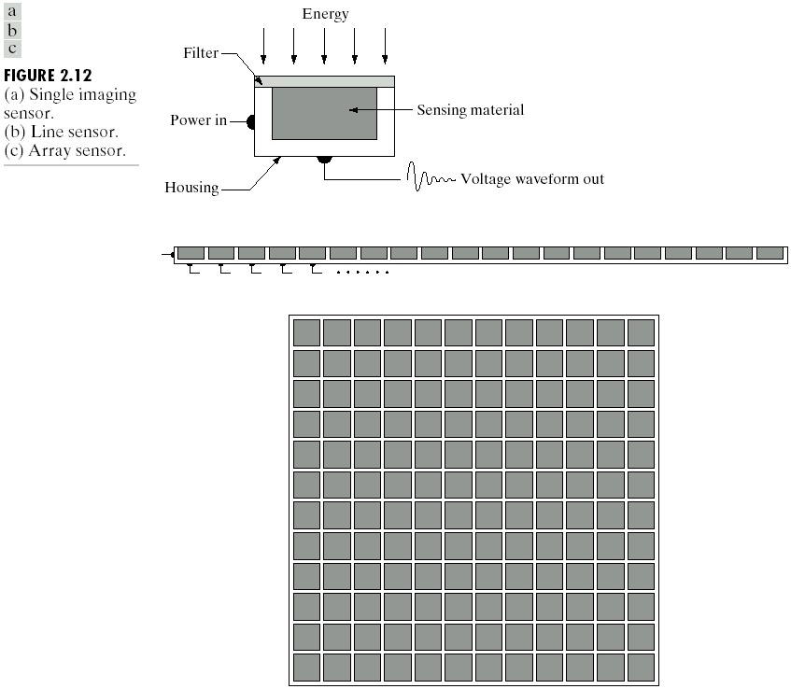
Image Sensing
Incoming energy lands on a sensor material responsive to that type of energy and this generates a voltage
Collections of sensors are arranged to capture images
Images taken from Gonzalez & Woods, Digital Image Processing (2002)
Imaging Sensor
Line of Image Sensors
Array of Image Sensors
Notes:
47

Slide 48
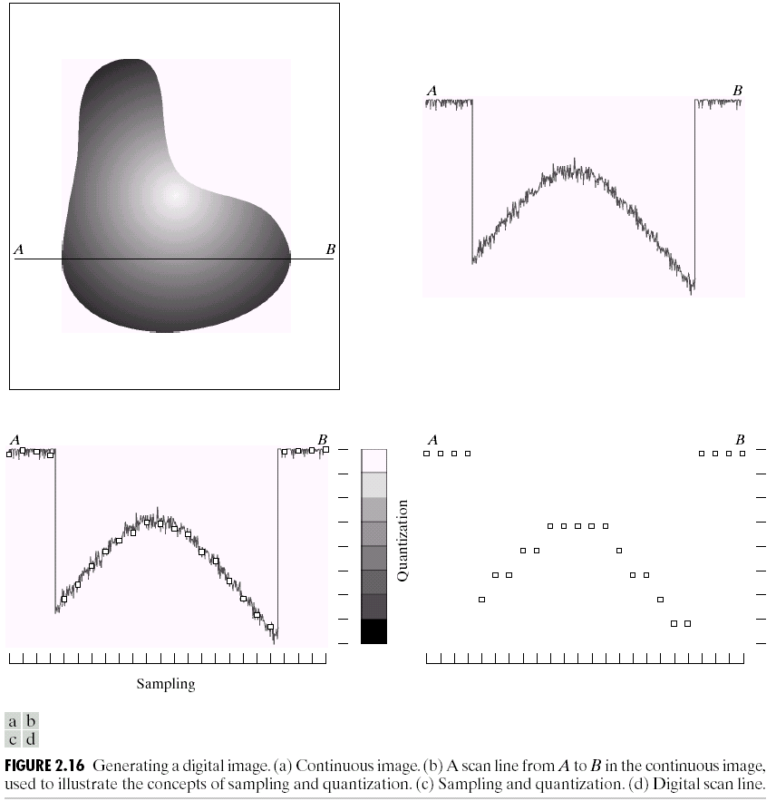
Image Sampling And Quantisation
A digital sensor can only measure a limited number of samples at a discrete set of energy levels
Quantisation is the process of converting a continuous analogue signal into a digital representation of this signal
Images taken from Gonzalez & Woods, Digital Image Processing (2002)
Notes:
48
Analogue Vs digital
Think of the volume knob on your stereo
Records Vs CDs Vs Mp3s
Nyquist theory etc talks about how much sampling we need to do

Slide 49
Image Sampling And Quantisation
Images taken from Gonzalez & Woods, Digital Image Processing (2002)
Notes:
49
Analogue Vs digital
Think of the volume knob on your stereo
Records Vs CDs Vs Mp3s
Nyquist theory etc talks about how much sampling we need to do

Slide 50
Image Sampling And Quantisation
Images taken from Gonzalez & Woods, Digital Image Processing (2002)
Notes:
50
Analogue Vs digital
Think of the volume knob on your stereo
Records Vs CDs Vs Mp3s
Nyquist theory etc talks about how much sampling we need to do

Slide 51
Image Sampling And Quantisation (cont…)
Remember that a digital image is always only an approximation of a real world scene
Images taken from Gonzalez & Woods, Digital Image Processing (2002)
Notes:
51

Slide 52
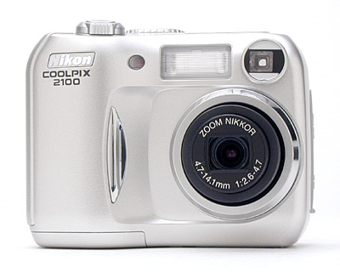
Spatial Resolution
The spatial resolution of an image is determined by how sampling was carried out
Spatial resolution simply refers to the smallest discernable detail in an image
Vision specialists will often talk about pixel size
Graphic designers will talk about dots per inch (DPI)
5.1 Megapixels
Notes:
52

Slide 53
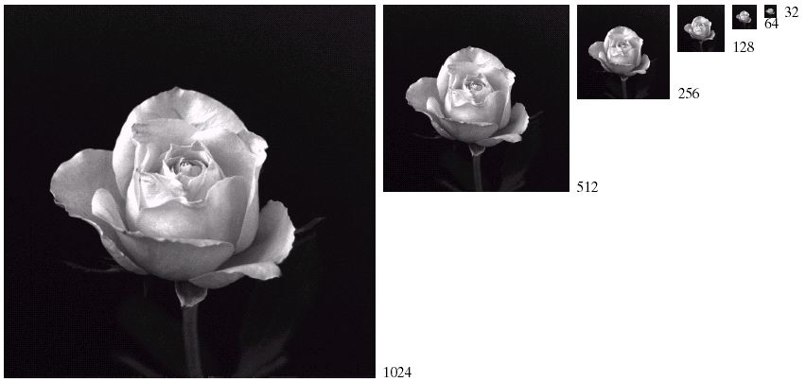
Spatial Resolution (cont…)
Images taken from Gonzalez & Woods, Digital Image Processing (2002)
Notes:
53

Slide 54
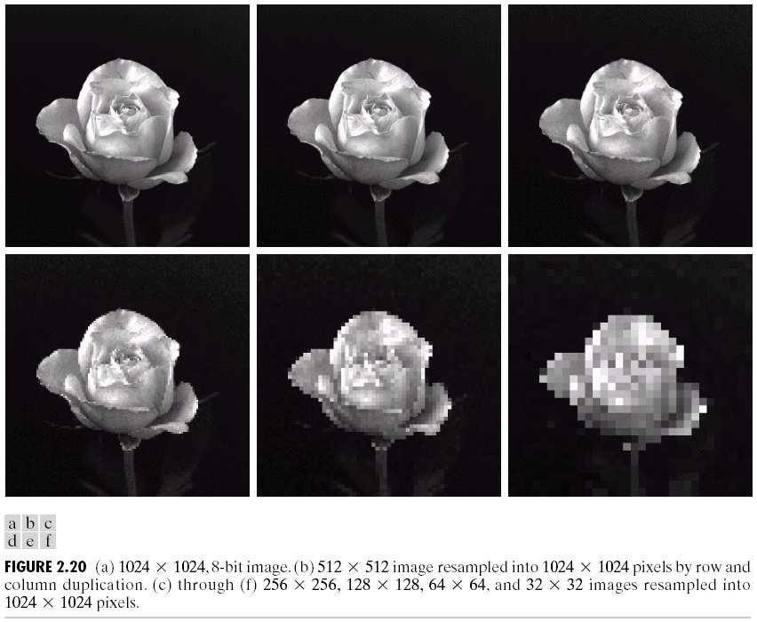
Spatial Resolution (cont…)
Images taken from Gonzalez & Woods, Digital Image Processing (2002)
Notes:
54

Slide 55
Spatial Resolution (cont…)
Images taken from Gonzalez & Woods, Digital Image Processing (2002)
Notes:
55

Slide 56
Spatial Resolution (cont…)
Images taken from Gonzalez & Woods, Digital Image Processing (2002)
Notes:
56

Slide 57
Spatial Resolution (cont…)
Images taken from Gonzalez & Woods, Digital Image Processing (2002)
Notes:
57

Slide 58
Spatial Resolution (cont…)
Images taken from Gonzalez & Woods, Digital Image Processing (2002)
Notes:
58

Slide 59
Spatial Resolution (cont…)
Images taken from Gonzalez & Woods, Digital Image Processing (2002)
Notes:
59

Slide 60
Intensity Level Resolution
Intensity level resolution refers to the number of intensity levels used to represent the image
The more intensity levels used, the finer the level of detail discernable in an image
Intensity level resolution is usually given in terms of the number of bits used to store each intensity level
Number of Bits
Number of Intensity Levels
Examples
1
2
0, 1
2
4
00, 01, 10, 11
4
16
0000, 0101, 1111
8
256
00110011, 01010101
16
65,536
1010101010101010
Notes:
60

Slide 61
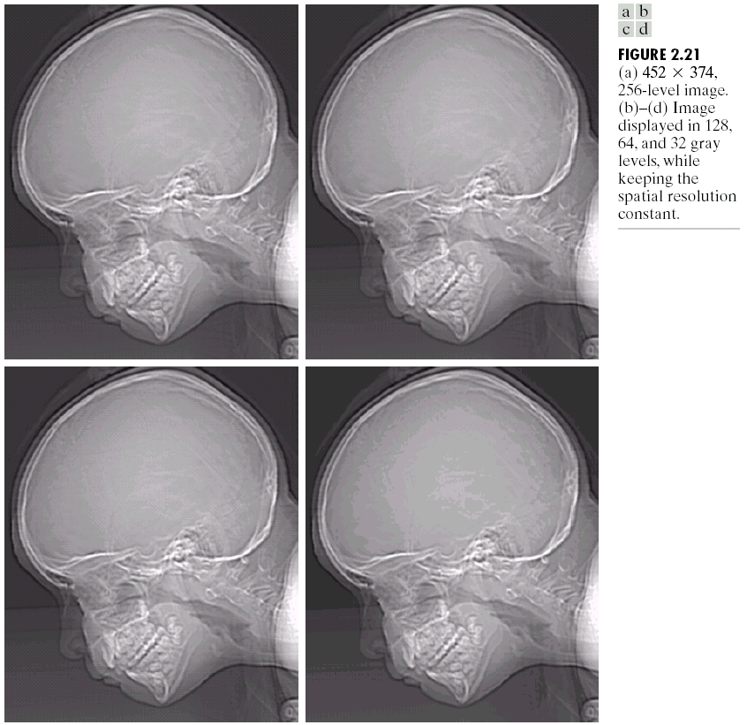

Intensity Level Resolution (cont…)
256 grey levels (8 bits per pixel)
128 grey levels (7 bpp)
64 grey levels (6 bpp)
32 grey levels (5 bpp)
Images taken from Gonzalez & Woods, Digital Image Processing (2002)
16 grey levels (4 bpp)
8 grey levels (3 bpp)
4 grey levels (2 bpp)
2 grey levels (1 bpp)
Notes:
61

Slide 62
Intensity Level Resolution (cont…)
Images taken from Gonzalez & Woods, Digital Image Processing (2002)
Notes:
62

Slide 63
Intensity Level Resolution (cont…)
Images taken from Gonzalez & Woods, Digital Image Processing (2002)
Notes:
63

Slide 64
Intensity Level Resolution (cont…)
Images taken from Gonzalez & Woods, Digital Image Processing (2002)
Notes:
64

Slide 65
Intensity Level Resolution (cont…)
Images taken from Gonzalez & Woods, Digital Image Processing (2002)
Notes:
65

Slide 66
Intensity Level Resolution (cont…)
Images taken from Gonzalez & Woods, Digital Image Processing (2002)
Notes:
66

Slide 67
Intensity Level Resolution (cont…)
Images taken from Gonzalez & Woods, Digital Image Processing (2002)
Notes:
67

Slide 68
Intensity Level Resolution (cont…)
Images taken from Gonzalez & Woods, Digital Image Processing (2002)
Notes:
68

Slide 69
Intensity Level Resolution (cont…)
Images taken from Gonzalez & Woods, Digital Image Processing (2002)
Notes:
69

Slide 70
Saturation & Noise
Images taken from Gonzalez & Woods, Digital Image Processing (2002)

Slide 71
Resolution: How Much Is Enough?
The big question with resolution is always how much is enough?
This all depends on what is in the image and what you would like to do with it
Key questions include
Does the image look aesthetically pleasing?
Can you see what you need to see within the image?
Notes:
71

Slide 72


Resolution: How Much Is Enough? (cont…)
The picture on the right is fine for counting the number of cars, but not for reading the number plate
Notes:
72

Slide 73

Intensity Level Resolution (cont…)
Images taken from Gonzalez & Woods, Digital Image Processing (2002)
Low Detail
Medium Detail
High Detail
Notes:
73

Slide 74
Intensity Level Resolution (cont…)
Images taken from Gonzalez & Woods, Digital Image Processing (2002)
Notes:
74

Slide 75
Intensity Level Resolution (cont…)
Images taken from Gonzalez & Woods, Digital Image Processing (2002)
Notes:
75

Slide 76
Intensity Level Resolution (cont…)
Images taken from Gonzalez & Woods, Digital Image Processing (2002)
Notes:
76

Slide 77
Summary
We have looked at:
Light and the electromagnetic spectrum
Image representation
Image sensing and acquisition
Sampling, quantisation and resolution
Next time we start to look at techniques for image enhancement
Notes:
77

Slide 78

Digital image representation
Monochrome image (or simply image) refers to a 2- dimensional light intensity function f(x,y)
– x and y denote spatial coordinates
– the value of f(x,y) at (x,y) is proportional to the brightness (or gray level) of the image at that point
Notes:
78

Slide 79
Digital image representation
A digital image is an image f(x,y) that has been discretized both in spatial coordinates and in brightness
• Considered as a matrix whose row and column indices represent a point in the image
• The corresponding matrix element value represents the gray level at that point
• The elements of such an array are referred to as: – image elements
– picture elements (pixels or pels)
Notes:
79

Slide 80
Steps in image processing
The problem domain in this example consists of pieces of mail and the objective is to read the address on each piece
Step 1: image acquisition
– Acquire a digital image using an image sensor
• a monochrome or color TV camera: produces an entire image of the problem domain every 1/30 second
• a line-scan camera: produces a single image line at a time, motion past the camera produces a 2-dimensional image
– If not digital, an analog-to-digital conversion process is required
– The nature of the image sensor (and the produced image) are determined by the application
• Mail reading applications rely greatly on line-scan cameras
• CCD and CMOS imaging sensors are very common in many applications
Notes:
80

Slide 81
Steps in image processing
• Step 2: preprocessing
– Key function: improve the image in ways that increase the chance for success of the other processes
– In the mail example, may deal with contrast enhancement, removing noise, and isolating regions whose texture indicates a likelihood of alphanumeric information
Notes:
81

Slide 82
Steps in image processing
• Step 3: segmentation
– Broadly defined: breaking an image into its constituent parts
– In general, one of the most difficult tasks in image processing
• Good segmentation simplifies the rest of the problem
• Poor segmentation make the task impossible
– Output is usually raw pixel data: may represent region boundaries, points in the region itself, etc.
• Boundary representation can be useful when the focus is on external shape characteristics (e.g. corners, rounded edges, etc.)
• Region representation is appropriate when the focus is on internal properties (e.g. texture or skeletal shape)
– For the mail problem (character recognition) both representations can be necessary
Notes:
82

Slide 83
Steps in image processing
• Step 4: representation & description
– Representation: transforming raw data into a form
suitable for computer processing
– Description (also called feature extraction) deals with extracting features that result in some quantitative information of interest or features which are basic for differentiating one class of objects from another
– In terms of character recognition, descriptors such as lakes (holes) and bays help differentiate one part of the alphabet from another
Notes:
83

Slide 84
Steps in image processing
• Step 5: recognition & interpretation
– Recognition: The process which assigns a label to an object based on the information provided by its descriptors
A may be the alphanumeric character A
– Interpretation: Assigning meaning to an ensemble of recognized objects
35487-0286 may be a ZIP code
Notes:
84

Slide 85

Steps in image processing
Notes:
85

Slide 86
A Knowledge Base
• Knowledge about a problem domain is coded into an image processing system in the form of a knowledge database
– May be simple:
• detailing areas of an image expected to be of interest
– May be complex
• A list of all possible defects of a material in a vision inspection system
– Guides operation of each processing module
– Controls interaction between modules
– Provides feedback through the system
Notes:
86

Slide 87

Sampling and Quantization
• To be suitable for computer processing an image, f(x,y) must be digitized both spatially and in amplitude
• Digitizing the spatial coordinates is called image sampling
• Amplitude digitization is called gray-level quantization
• f(x,y) is approximated by equally spaced samples in the form of an NxM array where each element is a discrete quantity
Notes:
87

Slide 88

Sampling and Quantization
• Common practice is to let N and M be powers of two; N=2^n and M=2^k
• And G=2^m where G denotes the number of gray levels
• The assumption here is that gray levels are equally space in the interval [0,L]
• The number of bits, b, necessary to store the image is then
• For example, a 128x128 image with 64 gray levels would require 98,304 bits of storage
Notes:
88

Slide 89

Sampling and Quantization
• How many samples and gray levels are required for a “good” approximation?
• The resolution (the degree of discernible detail) depends strongly on these two parameters
Notes:
89

Slide 90

Effects of reducing spatial resolution
Notes:
90

Slide 91

Effects of reducing gray levels
Notes:
91

Slide 92
Basic relationships between pixels
An image is denoted by: f(x,y)
Lowercase letters (e.g. p, q) will denote individual pixels
A subset of f(x,y) is denoted by S
Neighbors of a pixel:
– A pixel p at (x,y) has 4 horizontal/vertical neighbors at
• (x+1,y),(x-1,y),(x,y+1)and(x,y-1)
• called the 4-neighbors of p: N4(p)
– A pixel p at (x,y) has 4 diagonal neighbors at
• (x+1,y+1),(x+1,y-1),(x-1,y+1)and(x-1,y-1)
• called the diagonal–neighbors of p:ND(p)
– The 4-neighbors and the diagonal-neighbors of p are called the 8-neighbors of p: N8(p)
Notes:
92

Slide 93

Connectivity between pixels
• Connectivity is an important concept in establishing boundaries of object and components of regions in an image
• When are two pixels connected?
– If they are adjacent in some sense (say they are 4-neighbors)
– and, if their gray levels satisfy a specified criterion of similarity (say they are equal)
• Example: given a binary image (e.g. gray scale = [0,1]), two pixels may be 4-neighbors but are not considered connected unless they have the same value
Notes:
93

Slide 94
Connectivity between pixels
• Let V be the set of values used to determine connectivity
– For example, in a binary image, V={1} for the connectivity of pixels
with a value of 1
– In a gray scale image, for the connectivity of pixels with a range of
intensity values of, say, 32 to 64, it follows that V={32,33,...,63,64}
– Consider three types of connectivity
• 4-connectivity: Pixels p and q with values from V are 4-connected if q is in the set N4(p)
• 8-connectivity: Pixels p and q with values from V are 8-connected if q is in the set N8(p)
• m-connectivity (mixed): Pixels p and q with values from V are
m-connected if
– q is in the set N4(p),or
– q is in the set ND(p) and the set N4(p) ∩ N4(q) is empty (This is the set of pixels that are 4-neighbors of p and q and whose values are from V)
Notes:
94

Slide 95

Connectivity between pixels
Notes:
95

Slide 96
Pixel adjacencies and paths
• Pixel p is adjacent to q if they are connected
– We can define 4-, 8-, or m-adjacency depending on the specified type of connectivity
• Two image subsets S1 and S2 are adjacent if some pixel in S1 is adjacent to S2
• A path from p at (x,y) to q at (s,t) is a sequence of distinct pixels with coordinates (x0,y0), (x1,y1),....., (xn,yn)
– Where (x0,y0)=(x,y) and (xn,yn)=(s,t) and
– (xi,yi) is adjacent to (xi-1,yi-1) for 1<= i <= n
– n is the length of the path
• If p and q are in S, then p is connected to q in S if there is a path from p to q consisting entirely of pixels in S
Notes:
96

Slide 97

Example paths
Notes:
97

Slide 98

Connected components
• For any pixel p in S, the set of pixels connected to p form a connected component of S
• Distinct connected components in S are said to be disjoint
Notes:
98

Slide 99

Labeling 4-connected components
• Consider scanning an image pixel by pixel from left to right and top to bottom
– Assume, for the moment, we are interested in 4-connected components
– Let p denote the pixel of interest, and r and t denote the upper and left neighbors of p, respectively
– The nature of the scanning process assures that r and t have been encountered (and labeled if 1) by the time p is encountered
Notes:
99

Slide 100
Labeling 4-connected components
• Consider the following procedure
if p=0 continue to the next position
if r=t=0 assign a new label to p (Ln)
if r=t=1 and they have the same label, assign that label to p
if only one of r and t are 1, assign its label to p
if r=t=1 and they have different labels, assign one label to p and note that the two labels are equivalent (that is r and t are connected through p)
At the end of the scan, sort pairs of equivalent labels into equivalence classes and assign a different label to each class
Notes:
100

Slide 101

Labeling 4-connected components (example)
Notes:
101

Slide 102

Labeling 8-connected components
• Proceed as in the 4-connected component labeling case, but also examine two upper diagonal neighbors (q and s) of p
Notes:
102

Slide 103

Labeling connected components in non-binary images
• The 4-connected or 8-connected labeling schemes can be extended to gray level images
• The set V may be used to connect into a component only those pixels within a specified range of pixel values
Notes:
103

Slide 104

Distance measures
• Given pixels p, q, and z at (x,y), (s,t) and (u,v) respectively,
• D is a distance function (or metric) if:
– D(p,q) ≥ 0 (D(p,q)=0 iff p=q),
– D(p,q) = D(q,p), and
– D(p,z) ≤ D(p,q) + D(q,z).
• The Euclidean distance between p and q is given by:
• The pixels having distance less than or equal to some value r from (x,y) are the points contained in a disk of radius r centered at (x,y)
Notes:
104

Slide 105


Distance measures
• The D4 distance (also called the city block distance) between p and q is given by:
• The pixels having a D4 distance less than some r from (x,y)
form a diamond centered at (x,y)
• Example: pixels where D4 ≤ 2
Notes:
105

Slide 106

Distance measures
• The D8 distance (also called the chessboard distance) between p and q is given by:
• The pixels having a D8 distance less than some r from (x,y)
form a square centered at (x,y)
• Example: pixels where D8 ≤ 2
Notes:
106

Slide 107
Distance measures and connectivity
• The D4 distance between two points p and q is the shortest 4-path between the two points
• The D8 distance between two points p and q is the shortest 8-path between the two points
• D4 and D8 may be considered, regardless of whether a connected path exists between them, because the definition of these distances involves only the pixel coordinates
• For m-connectivity, the value of the distance (the length of the path) between two points depends on the values of the pixels along the path
Notes:
107

Slide 108

Distance measures and m-connectivity
• Consider the given arrangement of pixels and assume
– p, p2 and p4 =1
– p1 and p3 can be 0 or 1
• If V={1} and p1 and p3 are 0, the m-distance (p, p4) is 2 If either p1 or p3 are 1, the m-distance (p, p4) is 3 If p1 and p3 are 1, the m-distance (p, p4) is 4
Notes:
108

Slide 109

M-connectivity example
Notes:
109

Slide 110
Arithmetic & logic operations
• Arithmetic & logic operations on images used extensively in most image processing applications
– May cover the entire image or a subset Arithmetic operation between pixels p and q are defined as:
– Addition: (p+q)
• Used often for image averaging to reduce noise
– Subtraction: (p-q)
• Used often for static background removal
– Multiplication: (p*q) (or pq, p×q)
• Used to correct gray-level shading
– Division: (p÷q) (or p/q)
• As in multiplication
Notes:
110

Slide 111
Logic operations
• Arithmetic operation between pixels p and q are defined as:
– AND: p AND q (also p⋅q)
– OR: p OR q (also p+q)
– COMPLEMENT: NOTq (also q’)
• Form a functionally complete set
• Applicable to binary images
• Basic tools in binary image processing, used for:
– Masking
– Feature detection
– Shape analysis
Notes:
111

Slide 112

Examples of logic operations
Notes:
112

Slide 113

Examples of logic operations
Notes:
113

Slide 114
Neighborhood-oriented operations
• Arithmetic and logical operations may take place on a subset of the image
– Typically neighborhood oriented
• Formulated in the context of mask operations (also
called template, window or filter operations)
• Basic concept:let the value of a pixel be a function of its (current) gray level and the gray level of its neighbors (in some sense)
Notes:
114

Slide 115


Neighborhood-oriented operations
• Consider the following subset of pixels in an image
• Suppose we want to filter the image by replacing the value at Z5 with the average value of the pixels in a 3x3 region centered around Z5
• Perform an operation of the form:
• and assign to z5 the value of z
Notes:
115

Slide 116



Neighborhood-oriented operations
• In the more general form, the operation may look like:
• This equation is widely used in image processing
• Proper selection of coefficients (weights) allows for operations such as
– noise reduction
– region thinning
– edge detection
Notes:
116

